Slide 1
Quantifying numerical diffusion and dispersion in D-Flow Flexible Mesh using a lock-exchange experiment
D. Koetsenruijter
ir. L.M. Keyzer, TU Delft, first supervisor
Prof. dr. J. Pietrzak, TU Delft, second supervisor

Slide 2
Content
Introduction
Research question
Background
Method
Results
Temperature variation
Layer variation
General observation
Conclusion
Upcoming
Notes:
What? D-Flow Flexible Mesh – used to numerically model shallow water equations in curvilinear (complex shaped) grids
Why? Drinking water systems, large coastal systems, river dynamics
How? Shallow water equations to model advection-diffusion problem, length-scale is much larger than vertical scale thus hydrostatic
Problem: Numerical diffusion and dispersion as a result of higher-order non-linear terms – salinity or velocity gradients in the vertical (turbulence).
Numerical diffusion: viscosity because it overdamps the approximation – adds inertia –
Numerical dispersion: overcompensates to account for discontinuities or steep gradients

Slide 3
Introduction
D-Flow Flexible Mesh
Advection-Diffusion problem
Numerical diffusion
Numerical dispersion
Lock-exchange experiment
Notes:
What? D-Flow Flexible Mesh – used to numerically model shallow water equations in curvilinear (complex shaped) grids
Why? Drinking water systems, large coastal systems, river dynamics
How? Shallow water equations to model advection-diffusion problem, length-scale is much larger than vertical scale thus hydrostatic
Problem: Numerical diffusion and dispersion as a result of higher-order non-linear terms – salinity or velocity gradients in the vertical (turbulence).
Numerical diffusion: viscosity because it overdamps the approximation – adds inertia –
Numerical dispersion: overcompensates to account for discontinuities or steep gradients

Slide 4
Research question
How much numerical diffusion and or dispersion does the D-Flow FM model produce when simulating a 3D lock-exchange experiment?
What physics?
Sensitivity
Error types per parameter and phenomena
Indicators
Notes:
How much numerical diffusion and or dispersion does the D-Flow FM model produce when sim-
ulating a 3D lock-exchange experiment?
1. What is the order of errors produced by D-Flow FM as a result of numerical diffusion and/or
dispersion?
2. How sensitive is the accuracy of the D-Flow FM model to time, space and numerically related
parameters?
3. What sort of errors are produced given different parameters?
4. What parameters in the D-Flow FM model have the largest influence on errors related to
numerical diffusion and dispersion?
5. Are there indicators that predict the occurrence of numerical diffusion and dispersion in D-
Flow FM?
6. How do the physics around the mixing layer develop and what influence does this have on the
accuracy numerical approximation in terms of numerical diffusion and -dispersion?
7. How does the frontal wave speed develop compared to solutions that might be expected
from the characteristic equations?
8. How do internal waves develop at different model parameters and settings?
9. What effect do internal waves have on the produced numerical errors?

Slide 5
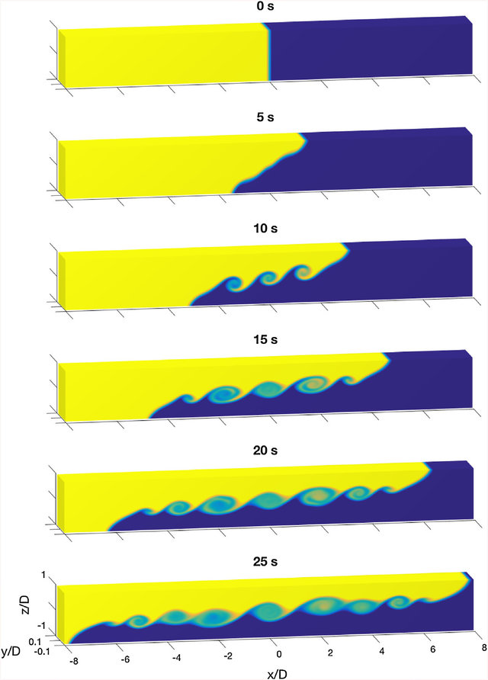
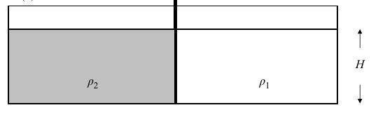
Background
Lock-exchange
Large discontinuity at t=0
Two wave fronts with steep gradients
Interface / mixing zone with turbulence eddys
Vertical velocity gradients
Figure 3.1: Basic lock-exchange setup - source: Shin et al. [2004]
Notes:
In this research the density difference is caused by a salinity difference.
At the start of the experiment (t=0) these fluids set in motion and from two wave fronts,
a negative and a positive as a result of the gravitational and buoyant forces.
depending on the velocity variations seen near the mixing zone the hydrostatic assumption is valid, this
often means the solution should be smoothly varying. For this reason near the negative and positive
wave fronts (see 3.2) and near the interface between the two density driven currents numerical errors
may be expected due to respectively steep salinity gradients causing large discontinuities and high
shear stresses causing turbulence thus vertical velocity gradient.
Because the continuity
equation can only account for small variations in the vertical velocity gradient when larger accelerations
occur numerical models show physically unrealistic phenomena such as water level elevations and
density differences at unsuspected locations.
The numerical errors produced during such an experiment have often been investigated and this
research aims to use the results obtained from this experiment as a measure for the order of accuracy
of the D-Flow FM numerical flow model.

Slide 6
Method
Modelling
Running simulations
Analyzing results
Discussion & conclusion
Notes:
To support answers to the research questions with data and reasonable arguments and thus finally
obtain an indication or even quantification of the numerical dispersion and -diffusion produced by D-
Flow FM the following research method is presented.

Slide 7
Method: Modelling
Constant parameters
Geometry
Timescale
Initial & boundary conditions
Stable output
Width averaged water level
Width averaged salinity
Notes:
During the modelling phase one determines a reference model through modelling large ranges of de-
sirably constant parameters. Based on a qualitative analysis of these results the model settings and
parameters that will remain constant throughout the further research are reasonably defined.
In this reference
model the observed numerical dispersion and -diffusion should be of an acceptable range and more
importantly subject to little change.

Slide 8
Method: Simulations
Interval analysis
Parameter variations
Temporal variation
Courant number
Δt
Spatial variaton
Δx /Δz
Δy/ Δz
meshgrid type
Forcing variation (salinity difference)
Other parameters
Notes:
During the modelling phase one determines a reference model through modelling large ranges of de-
sirably constant parameters. Based on a qualitative analysis of these results the model settings and
parameters that will remain constant throughout the further research are reasonably defined.
In this reference
model the observed numerical dispersion and -diffusion should be of an acceptable range and more
importantly subject to little change.

Slide 9
Method: Analysis
Numerical evaluation criteria
Von Neumann condition (Amplification factor)
CFL condition (Positive numerical diffusion, domain of influence)
Computational stability (Domain of influence)
Heuristic stability
Monotonicity
Spectral analysis
Ruano et. al, 2019
Dispersion error evaluation method
Sensitivity analysis
S(P) = δx/δP
Notes:
In practice, this new analysis allows the numerical study of dispersion errors on all types of
mesh and for multiple dimensions. Nonetheless, when mesh uniformity and one-dimensionality assumptions
are imposed as in the classical method, the results of this new technique coincide with those of the classic
method.

Slide 10
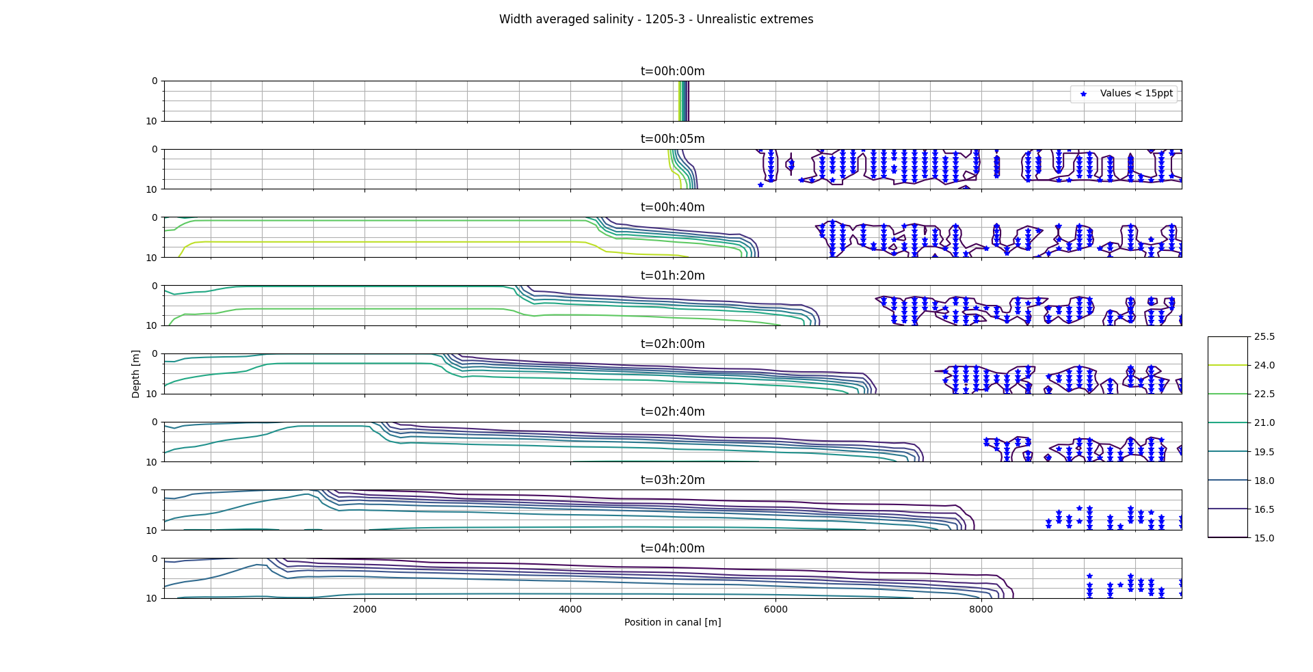
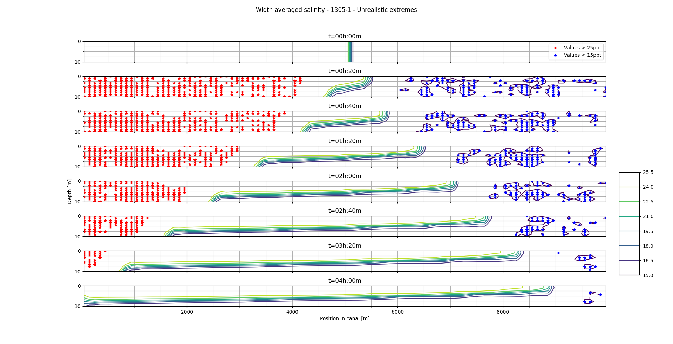
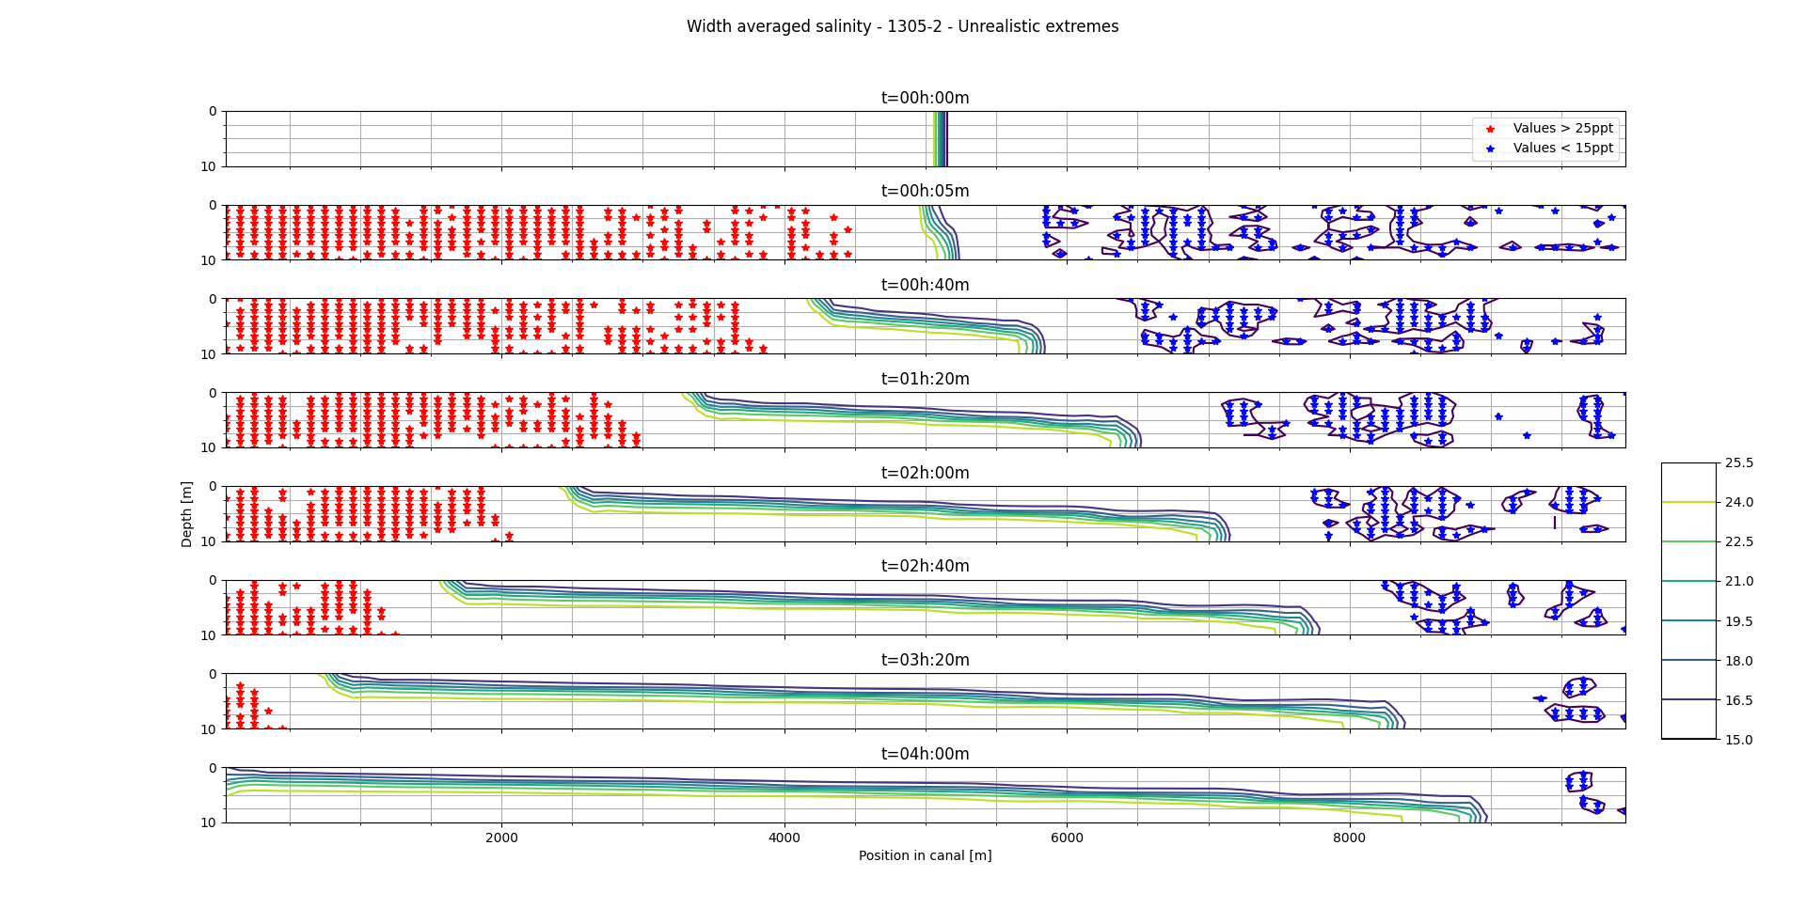
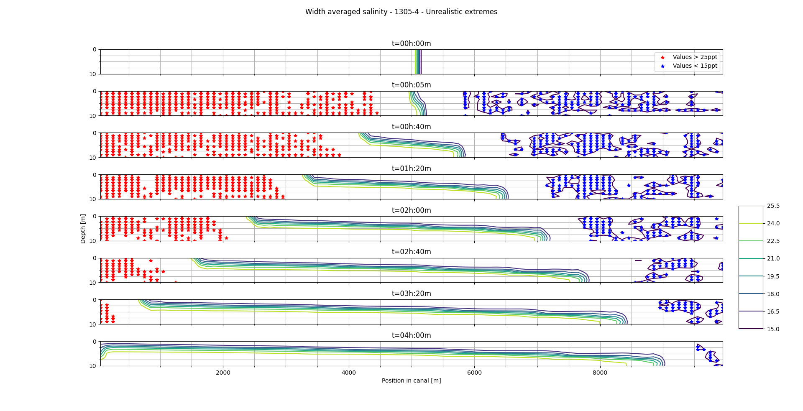
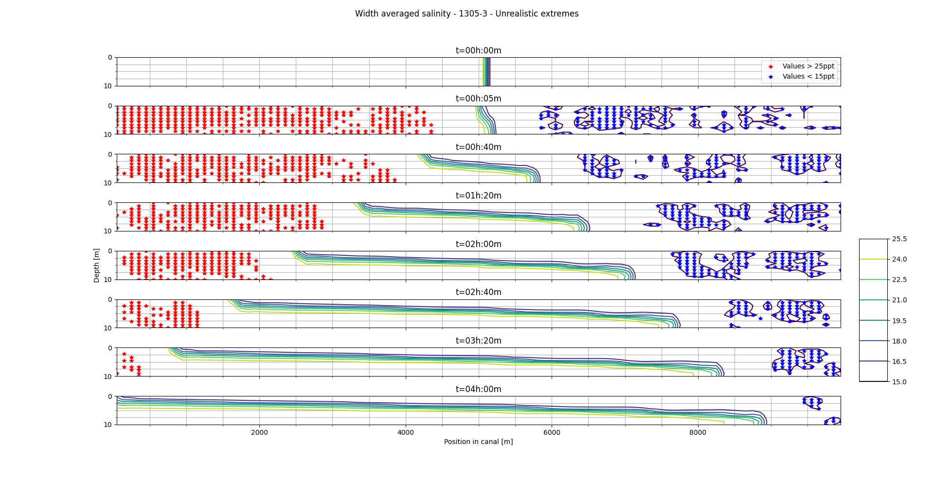
Results
Temperature variation
Layer variation
General observation
Conclusion
Notes:
In practice, this new analysis allows the numerical study of dispersion errors on all types of
mesh and for multiple dimensions. Nonetheless, when mesh uniformity and one-dimensionality assumptions
are imposed as in the classical method, the results of this new technique coincide with those of the classic
method.

Slide 11
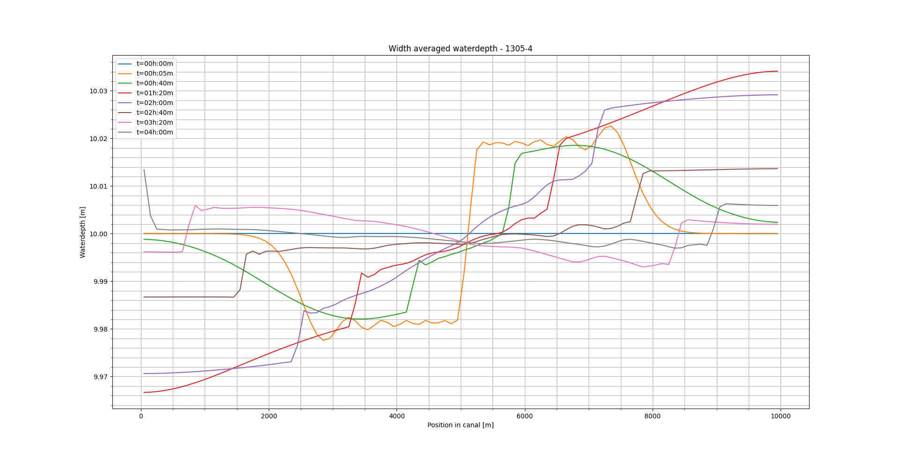
Results: Temperature variation
T=0
Notes:
• When the temperature is higher, in the first time step, oscillations in the water profile can be seen
in front of the disturbance, besides a large discontinuity around the center of the grid is observed.
The fact that these oscillations are not observed at a temperature of 6 degC can be explained
due to the relative effect the salinity difference has on the initial density difference, because this
effect is smaller at lower temperatures due to a higher density of the water itself the disturbance is
of a lower order than at higher temperature. These oscillations are could be a form of numerical
dispersion and may be attributed to the hydrostatic assumption of the model, i.e. to compensate
for the large vertical velocity gradient in the center of the grid at t=5min the model imposes a water
level difference (the large discontinuity). Subsequently to deal with this water level difference in
the middle of the grid, the approximation shows oscillations, i.e. in order to bridge the discontinuity
in the water level and approximate the original water level at locations where the disturbance has
not yet had any influence.
• Other oscillations are observed after the wave fronts (especially the high density wave) has
passed. These oscillations could be a result of the artificial viscosity of the model, a process
imposed to mimic energy loss due to heat transfer, this results in a transfer of kinetic energy in
the form of waves. However, they could also be a result of the internal waves formed due to
friction at the interface of the two density currents. Because in this mixing layer turbulence is
likely to occur the model could show oscillations in the water level to compensate for the vertical
velocity gradients associated with turbulence.

Slide 12

T=4
Notes:
• When the temperature is higher, in the first time step, oscillations in the water profile can be seen
in front of the disturbance, besides a large discontinuity around the center of the grid is observed.
The fact that these oscillations are not observed at a temperature of 6 degC can be explained
due to the relative effect the salinity difference has on the initial density difference, because this
effect is smaller at lower temperatures due to a higher density of the water itself the disturbance is
of a lower order than at higher temperature. These oscillations are could be a form of numerical
dispersion and may be attributed to the hydrostatic assumption of the model, i.e. to compensate
for the large vertical velocity gradient in the center of the grid at t=5min the model imposes a water
level difference (the large discontinuity). Subsequently to deal with this water level difference in
the middle of the grid, the approximation shows oscillations, i.e. in order to bridge the discontinuity
in the water level and approximate the original water level at locations where the disturbance has
not yet had any influence.
• Other oscillations are observed after the wave fronts (especially the high density wave) has
passed. These oscillations could be a result of the artificial viscosity of the model, a process
imposed to mimic energy loss due to heat transfer, this results in a transfer of kinetic energy in
the form of waves. However, they could also be a result of the internal waves formed due to
friction at the interface of the two density currents. Because in this mixing layer turbulence is
likely to occur the model could show oscillations in the water level to compensate for the vertical
velocity gradients associated with turbulence.

Slide 13
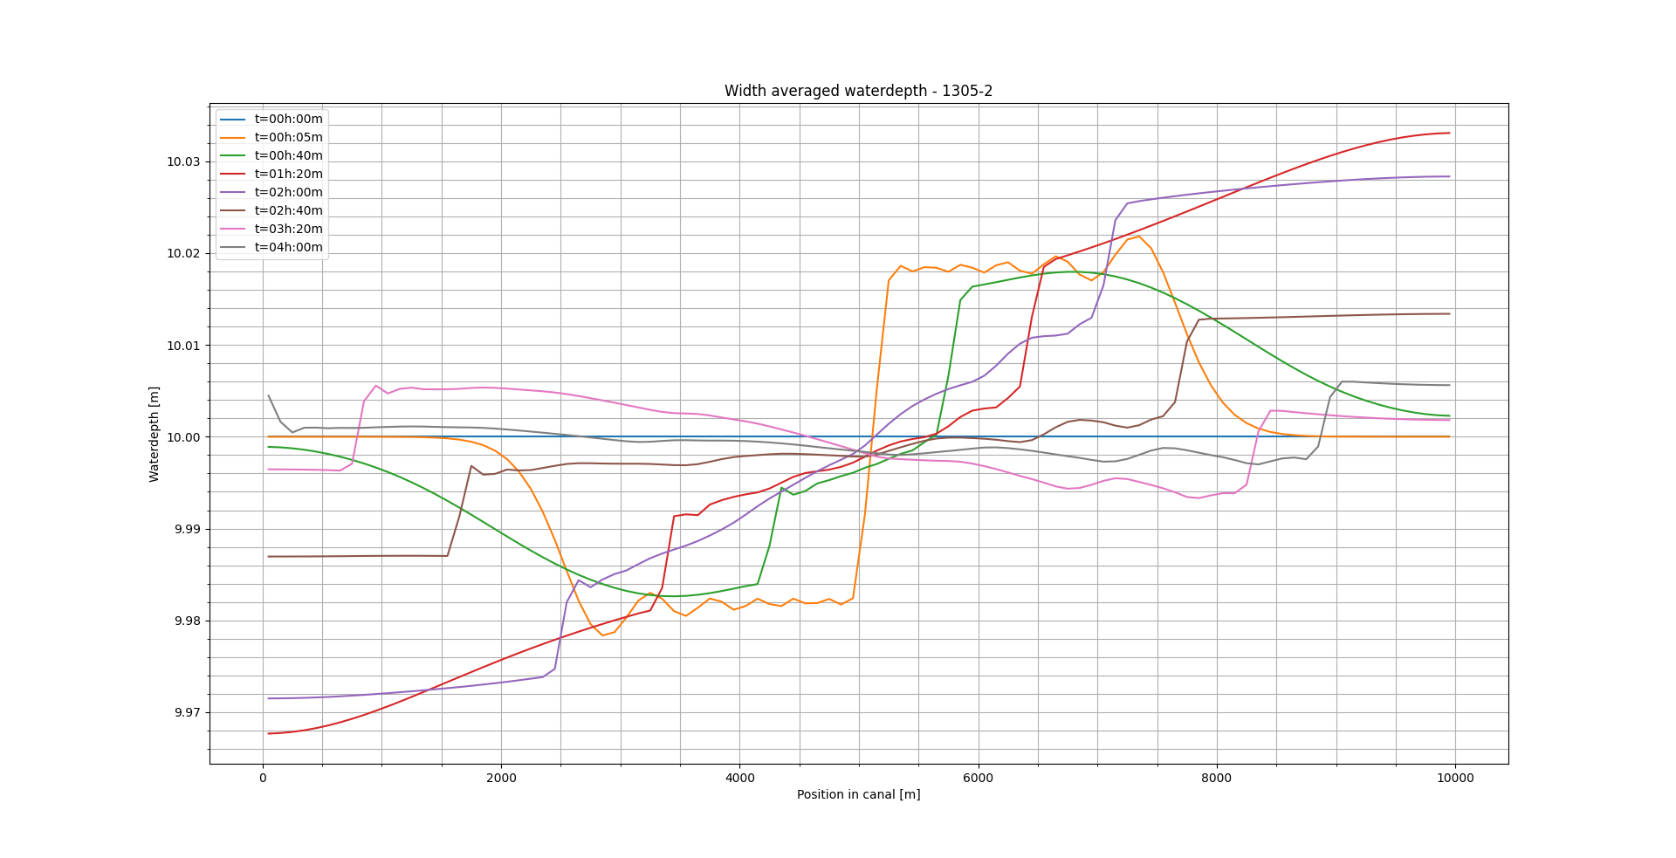
T=10
Notes:
• When the temperature is higher, in the first time step, oscillations in the water profile can be seen
in front of the disturbance, besides a large discontinuity around the center of the grid is observed.
The fact that these oscillations are not observed at a temperature of 6 degC can be explained
due to the relative effect the salinity difference has on the initial density difference, because this
effect is smaller at lower temperatures due to a higher density of the water itself the disturbance is
of a lower order than at higher temperature. These oscillations are could be a form of numerical
dispersion and may be attributed to the hydrostatic assumption of the model, i.e. to compensate
for the large vertical velocity gradient in the center of the grid at t=5min the model imposes a water
level difference (the large discontinuity). Subsequently to deal with this water level difference in
the middle of the grid, the approximation shows oscillations, i.e. in order to bridge the discontinuity
in the water level and approximate the original water level at locations where the disturbance has
not yet had any influence.
• Other oscillations are observed after the wave fronts (especially the high density wave) has
passed. These oscillations could be a result of the artificial viscosity of the model, a process
imposed to mimic energy loss due to heat transfer, this results in a transfer of kinetic energy in
the form of waves. However, they could also be a result of the internal waves formed due to
friction at the interface of the two density currents. Because in this mixing layer turbulence is
likely to occur the model could show oscillations in the water level to compensate for the vertical
velocity gradients associated with turbulence.

Slide 14
Results: Temperature variation
Observations related to the waterlevel:
Oscillations ‘downstream’
Oscillations ‘upstream’
Notes:
When the temperature is higher, in the first time step, oscillations in the water profile can be seen
in front of the disturbance, besides a large discontinuity around the center of the grid is observed.
These oscillations are could be a form of numerical
dispersion and may be attributed to the hydrostatic assumption of the model, i.e. to compensate
for the large vertical velocity gradient in the center of the grid at t=5min the model imposes a water
level difference (the large discontinuity). Subsequently to deal with this water level difference in
the middle of the grid, the approximation shows oscillations, i.e. in order to bridge the discontinuity
in the water level and approximate the original water level at locations where the disturbance has
not yet had any influence.
Other oscillations are observed after the wave fronts (especially the high density wave) has
passed. These oscillations could be a result of the artificial viscosity of the model, a process
imposed to mimic energy loss due to heat transfer, this results in a transfer of kinetic energy in
the form of waves. However, they could also be a result of the internal waves formed due to
friction at the interface of the two density currents. Because in this mixing layer turbulence is
likely to occur the model could show oscillations in the water level to compensate for the vertical
velocity gradients associated with turbulence.

Slide 15
Results: Temperature variation
T=0
T = 0
Notes:
As to the salinity some observations can be made.
• The frontal wave speeds at both fronts are almost linear over time. This indicates an energy
conserving approximation may be valid.
• The frontal wave speed in the high density wave is lower than in the low density wave. This is
probably because of the bed friction.
• At 6 degrees Celsius the model shows numerical diffusion characteristics for the low density
wave. At higher temperatures it shows no direct numerical diffusion characteristics. However at
4 degrees Celsius on a different run it shows no such numerical diffusion characteristics. It is
unclear why simulation 1205-3 shows this behaviour.
• At 4 degrees Celsius the frontal wave speeds are higher than at higher temperatures (10 and 15
degC). This can be explained through the formula that estimates the frontal wave speed based
on the density difference and the water depth: U = 0.5·√(g’·d). Where g’=g(ρ2-ρ1)/ρ2, given ρ1 <
ρ2. [Pietrzak, 1998]. If the density of water decreases the factor (ρ2-ρ1)/ρ2 will decrease as well,
thus increasing the effect of the salinity difference. Now, because water has it’s highest density
at 4 degrees Celsius, the effect of the density difference due to the salinity increases at higher or
lower temperatures, meaning the reduced gravity will be smaller and thus the frontal wave speed
will be smaller. This explains that wave frontal speed will be at its maximum at 4 degrees Celsius.
• At locations where internal waves may be formed the plot should be more detailed to draw con-
clusions. Also velocity profiles would be desirable.

Slide 16
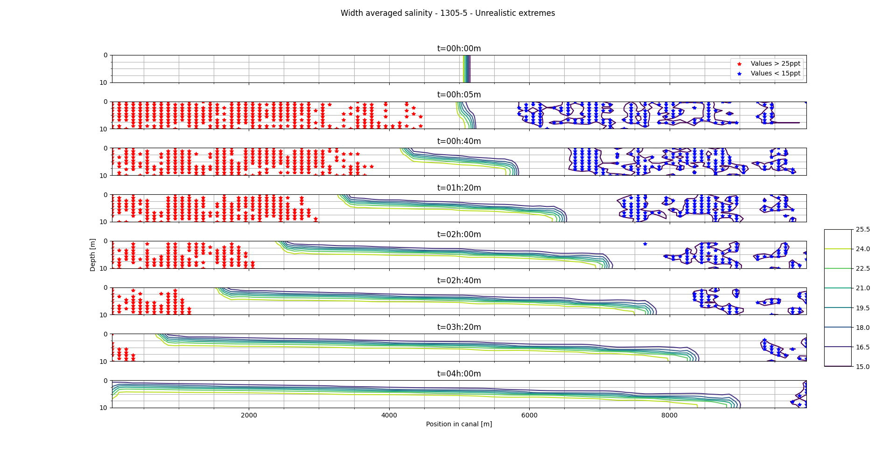
Results: Temperature variation
T=4
T = 4
Notes:
As to the salinity some observations can be made.
• The frontal wave speeds at both fronts are almost linear over time. This indicates an energy
conserving approximation may be valid.
• The frontal wave speed in the high density wave is lower than in the low density wave. This is
probably because of the bed friction.
• At 6 degrees Celsius the model shows numerical diffusion characteristics for the low density
wave. At higher temperatures it shows no direct numerical diffusion characteristics. However at
4 degrees Celsius on a different run it shows no such numerical diffusion characteristics. It is
unclear why simulation 1205-3 shows this behaviour.
• At 4 degrees Celsius the frontal wave speeds are higher than at higher temperatures (10 and 15
degC). This can be explained through the formula that estimates the frontal wave speed based
on the density difference and the water depth: U = 0.5·√(g’·d). Where g’=g(ρ2-ρ1)/ρ2, given ρ1 <
ρ2. [Pietrzak, 1998]. If the density of water decreases the factor (ρ2-ρ1)/ρ2 will decrease as well,
thus increasing the effect of the salinity difference. Now, because water has it’s highest density
at 4 degrees Celsius, the effect of the density difference due to the salinity increases at higher or
lower temperatures, meaning the reduced gravity will be smaller and thus the frontal wave speed
will be smaller. This explains that wave frontal speed will be at its maximum at 4 degrees Celsius.
• At locations where internal waves may be formed the plot should be more detailed to draw con-
clusions. Also velocity profiles would be desirable.

Slide 17
Results: Temperature variation
T=10
T = 10
Notes:
As to the salinity some observations can be made.
• The frontal wave speeds at both fronts are almost linear over time. This indicates an energy
conserving approximation may be valid.
• The frontal wave speed in the high density wave is lower than in the low density wave. This is
probably because of the bed friction.
• At 6 degrees Celsius the model shows numerical diffusion characteristics for the low density
wave. At higher temperatures it shows no direct numerical diffusion characteristics. However at
4 degrees Celsius on a different run it shows no such numerical diffusion characteristics. It is
unclear why simulation 1205-3 shows this behaviour.
• At 4 degrees Celsius the frontal wave speeds are higher than at higher temperatures (10 and 15
degC). This can be explained through the formula that estimates the frontal wave speed based
on the density difference and the water depth: U = 0.5·√(g’·d). Where g’=g(ρ2-ρ1)/ρ2, given ρ1 <
ρ2. [Pietrzak, 1998]. If the density of water decreases the factor (ρ2-ρ1)/ρ2 will decrease as well,
thus increasing the effect of the salinity difference. Now, because water has it’s highest density
at 4 degrees Celsius, the effect of the density difference due to the salinity increases at higher or
lower temperatures, meaning the reduced gravity will be smaller and thus the frontal wave speed
will be smaller. This explains that wave frontal speed will be at its maximum at 4 degrees Celsius.
• At locations where internal waves may be formed the plot should be more detailed to draw con-
clusions. Also velocity profiles would be desirable.

Slide 18
Results: Temperature variation
Observations related to the salinity:
Linear frontal wavespeeds
Higher FWS at 4 degrees Celsius
More detailed plot at locations of internal waves
Notes:
The frontal wave speeds at both fronts are almost linear over time. This indicates an energy
conserving approximation may be valid.
• The frontal wave speed in the high density wave is lower than in the low density wave. This is
probably because of the bed friction.
• At 6 degrees Celsius the model shows numerical diffusion characteristics for the low density
wave. At higher temperatures it shows no direct numerical diffusion characteristics. However at
4 degrees Celsius on a different run it shows no such numerical diffusion characteristics. It is
unclear why simulation 1205-3 shows this behaviour.
• At 4 degrees Celsius the frontal wave speeds are higher than at higher temperatures (10 and 15
degC). This can be explained through the formula that estimates the frontal wave speed based
on the density difference and the water depth: U = 0.5·√(g’·d). Where g’=g(ρ2-ρ1)/ρ2, given ρ1 <
ρ2. [Pietrzak, 1998]. If the density of water decreases the factor (ρ2-ρ1)/ρ2 will decrease as well,
thus increasing the effect of the salinity difference. Now, because water has it’s highest density
at 4 degrees Celsius, the effect of the density difference due to the salinity increases at higher or
lower temperatures, meaning the reduced gravity will be smaller and thus the frontal wave speed
will be smaller. This explains that wave frontal speed will be at its maximum at 4 degrees Celsius.
• At locations where internal waves may be formed the plot should be more detailed to draw con-
clusions. Also velocity profiles would be desirable.
Because the temperature difference has an indirect effect on the forcing it is desirable to keep this at
a constant level and try out a range of different salinity deltas. With this reasoning a default temperature
of 4 degrees Celsius should be sustained. A final check in 1305-4 where a background temperature of
0 degrees Celsius, shows similar results as obtained from 1305-2 where a temperature of 10 degrees
Celsius was set. Given that the density of water at 0 degrees (9998.7 kg/m3) and 10 degrees (9997.5
kg/m3) are similar, this substantiates this similarity. Finally the results obtained in a situation with 4
degree Celsius is presented.

Slide 19
L=10
Notes:
• When the temperature is higher, in the first time step, oscillations in the water profile can be seen
in front of the disturbance, besides a large discontinuity around the center of the grid is observed.
The fact that these oscillations are not observed at a temperature of 6 degC can be explained
due to the relative effect the salinity difference has on the initial density difference, because this
effect is smaller at lower temperatures due to a higher density of the water itself the disturbance is
of a lower order than at higher temperature. These oscillations are could be a form of numerical
dispersion and may be attributed to the hydrostatic assumption of the model, i.e. to compensate
for the large vertical velocity gradient in the center of the grid at t=5min the model imposes a water
level difference (the large discontinuity). Subsequently to deal with this water level difference in
the middle of the grid, the approximation shows oscillations, i.e. in order to bridge the discontinuity
in the water level and approximate the original water level at locations where the disturbance has
not yet had any influence.
• Other oscillations are observed after the wave fronts (especially the high density wave) has
passed. These oscillations could be a result of the artificial viscosity of the model, a process
imposed to mimic energy loss due to heat transfer, this results in a transfer of kinetic energy in
the form of waves. However, they could also be a result of the internal waves formed due to
friction at the interface of the two density currents. Because in this mixing layer turbulence is
likely to occur the model could show oscillations in the water level to compensate for the vertical
velocity gradients associated with turbulence.

Slide 20
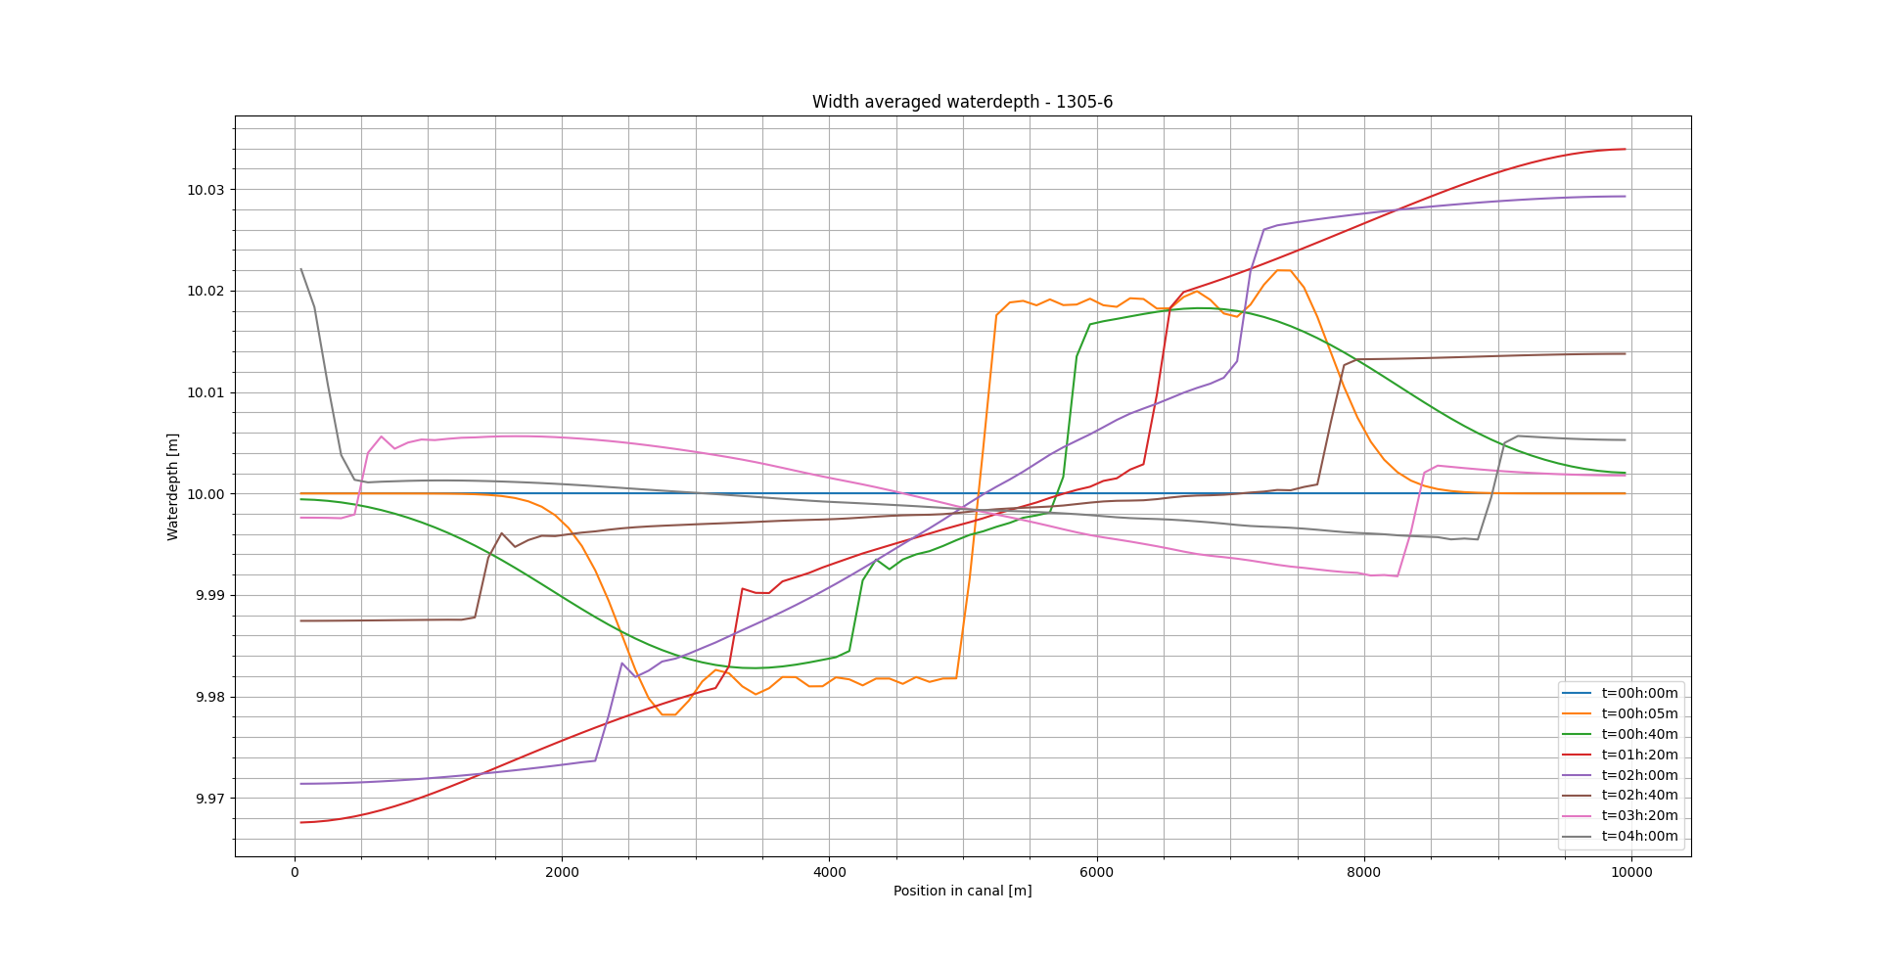
Results: Layer variation
L=20
L=20
Notes:
The water level seems across all levels seems similar except for the oscillations at locations where
the front has already passed, and ofcourse the difference in wave speed can be observed. In fact
compared to the 10 layered model short oscillations seem to disappear with 20, 50 and 99 layers.
However these shorter oscillations seem to be replaced by a single larger oscillation near the end
of the simulation (between t=2h and t=4h), increasingly large as the number of layers increase.
This could be attributed to the gradual compensation of the water level difference between the
locations where the two wave fronts are situated, but it could also be a measure of the internal
waves formed at the interface of the two density currents to compensate for the vertical velocity.
This requires further investigation.
• Small oscillations around a constant water level difference across the first 3km of the grid, in
each direction, at t=5min are similar across all simulations and indicate numerical dispersion to
compensate for the discontinuity of the initial disturbance.
• The water level differences at the locations of each wave front are again expected to be caused
by the vertical velocity gradients near the wave fronts for which the model compensates with a
water level rise, to fulfill the hydrostatic condition.
• At a larger number of layers the absolute water level difference across the first 3km of the grid, in
each direction, seems to persist longer in the first 40min of the simulation.

Slide 21
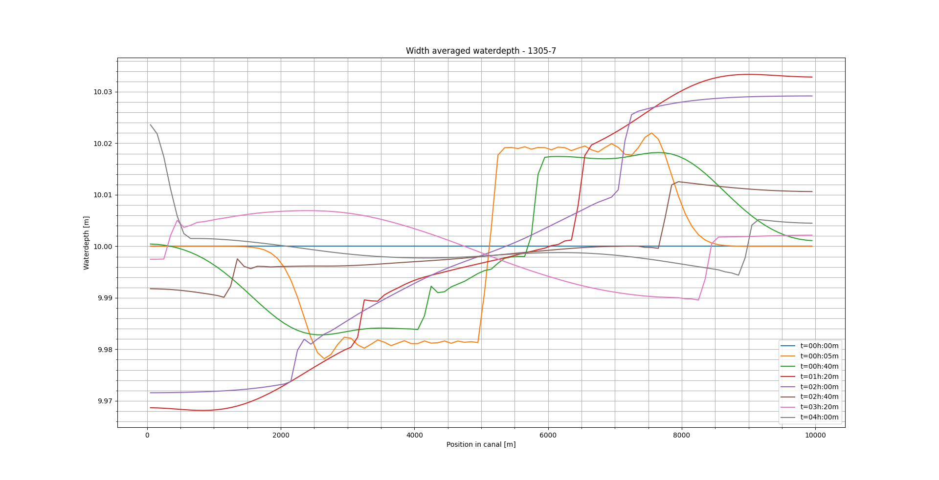
Results: Layer variation
L=50
L=50
Notes:
The water level seems across all levels seems similar except for the oscillations at locations where
the front has already passed, and ofcourse the difference in wave speed can be observed. In fact
compared to the 10 layered model short oscillations seem to disappear with 20, 50 and 99 layers.
However these shorter oscillations seem to be replaced by a single larger oscillation near the end
of the simulation (between t=2h and t=4h), increasingly large as the number of layers increase.
This could be attributed to the gradual compensation of the water level difference between the
locations where the two wave fronts are situated, but it could also be a measure of the internal
waves formed at the interface of the two density currents to compensate for the vertical velocity.
This requires further investigation.
• Small oscillations around a constant water level difference across the first 3km of the grid, in
each direction, at t=5min are similar across all simulations and indicate numerical dispersion to
compensate for the discontinuity of the initial disturbance.
• The water level differences at the locations of each wave front are again expected to be caused
by the vertical velocity gradients near the wave fronts for which the model compensates with a
water level rise, to fulfill the hydrostatic condition.
• At a larger number of layers the absolute water level difference across the first 3km of the grid, in
each direction, seems to persist longer in the first 40min of the simulation.

Slide 22
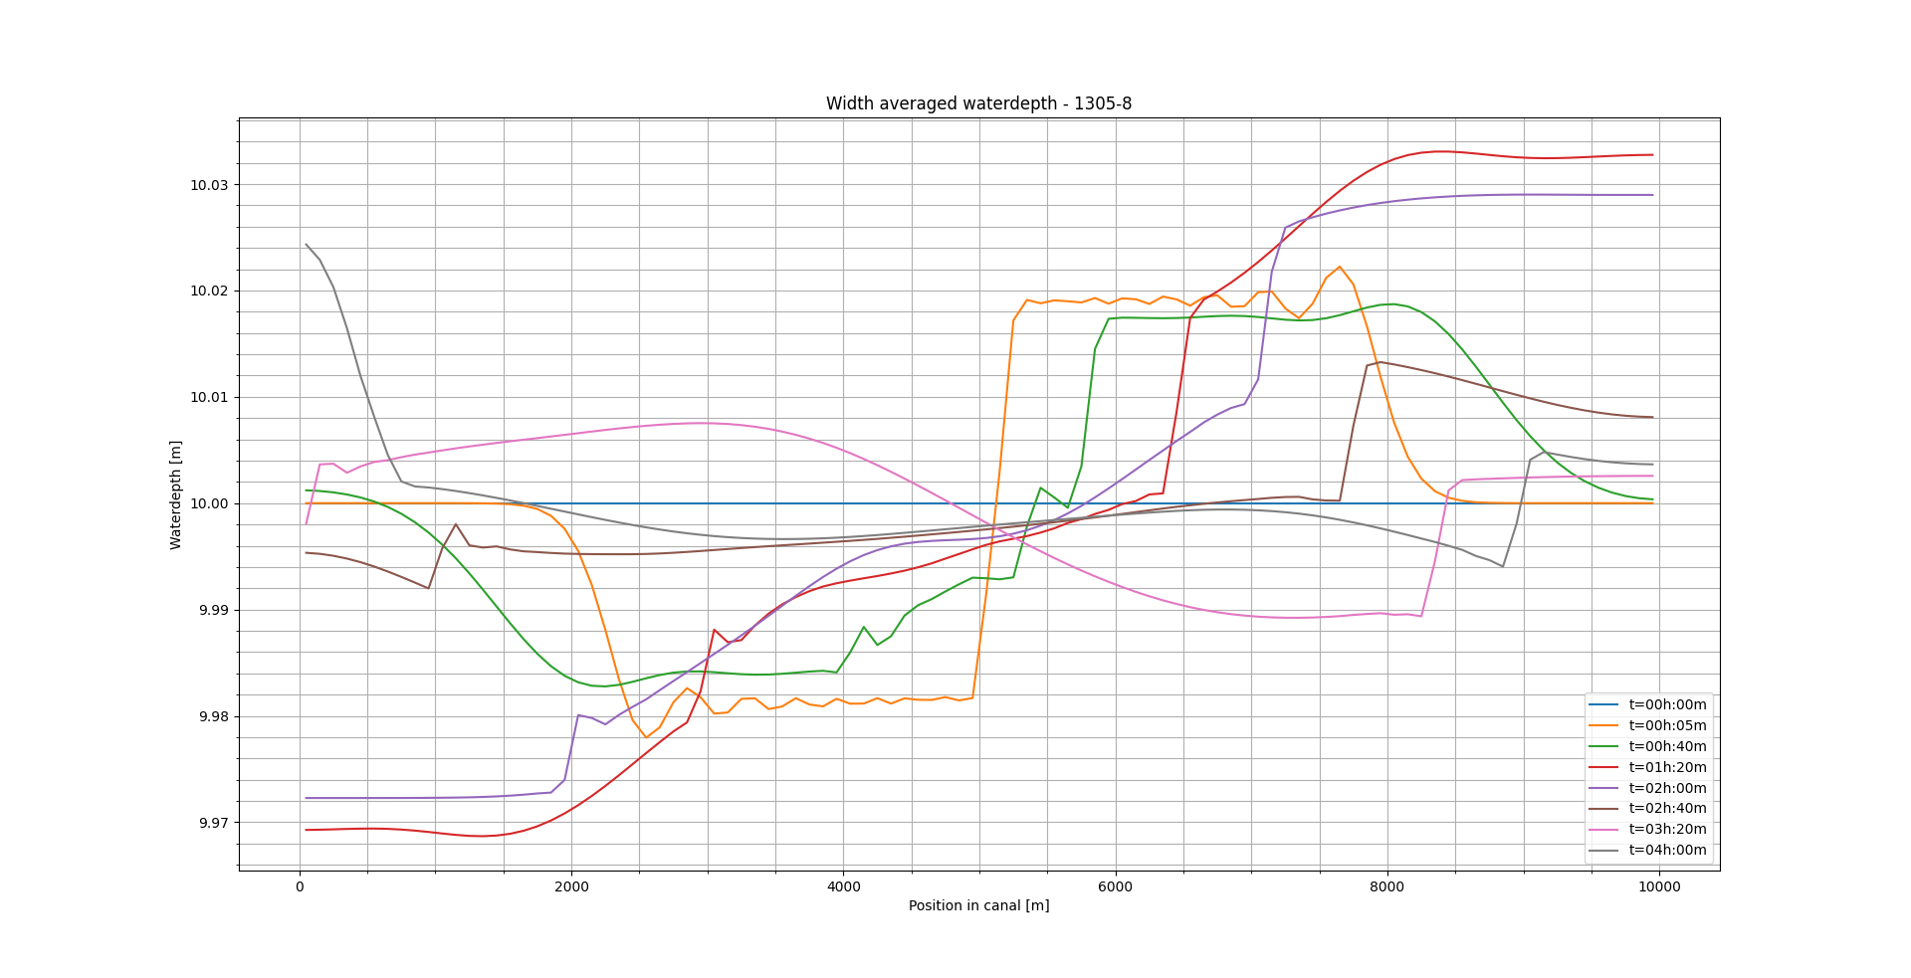
Results: Layer variation
L=99
L=99
Notes:
The water level seems across all levels seems similar except for the oscillations at locations where
the front has already passed, and ofcourse the difference in wave speed can be observed. In fact
compared to the 10 layered model short oscillations seem to disappear with 20, 50 and 99 layers.
However these shorter oscillations seem to be replaced by a single larger oscillation near the end
of the simulation (between t=2h and t=4h), increasingly large as the number of layers increase.
This could be attributed to the gradual compensation of the water level difference between the
locations where the two wave fronts are situated, but it could also be a measure of the internal
waves formed at the interface of the two density currents to compensate for the vertical velocity.
This requires further investigation.
• Small oscillations around a constant water level difference across the first 3km of the grid, in
each direction, at t=5min are similar across all simulations and indicate numerical dispersion to
compensate for the discontinuity of the initial disturbance.
• The water level differences at the locations of each wave front are again expected to be caused
by the vertical velocity gradients near the wave fronts for which the model compensates with a
water level rise, to fulfill the hydrostatic condition.
• At a larger number of layers the absolute water level difference across the first 3km of the grid, in
each direction, seems to persist longer in the first 40min of the simulation.

Slide 23
Results: Layer variation
Observations related to the waterlevel:
Short oscillations replaced by longer one
Longer period of short oscillations ‘downstream’
Notes:
The water level seems across all levels seems similar except for the oscillations at locations where
the front has already passed, and ofcourse the difference in wave speed can be observed. In fact
compared to the 10 layered model short oscillations seem to disappear with 20, 50 and 99 layers.
However these shorter oscillations seem to be replaced by a single larger oscillation near the end
of the simulation (between t=2h and t=4h), increasingly large as the number of layers increase.
This could be attributed to the gradual compensation of the water level difference between the
locations where the two wave fronts are situated, but it could also be a measure of the internal
waves formed at the interface of the two density currents to compensate for the vertical velocity.
This requires further investigation.
• Small oscillations around a constant water level difference across the first 3km of the grid, in
each direction, at t=5min are similar across all simulations and indicate numerical dispersion to
compensate for the discontinuity of the initial disturbance.
• The water level differences at the locations of each wave front are again expected to be caused
by the vertical velocity gradients near the wave fronts for which the model compensates with a
water level rise, to fulfill the hydrostatic condition.
• At a larger number of layers the absolute water level difference across the first 3km of the grid, in
each direction, seems to persist longer in the first 40min of the simulation.

Slide 24
Results: Temperature variation
L=10
T = 4
Notes:
As to the salinity some observations can be made.
• The frontal wave speeds at both fronts are almost linear over time. This indicates an energy
conserving approximation may be valid.
• The frontal wave speed in the high density wave is lower than in the low density wave. This is
probably because of the bed friction.
• At 6 degrees Celsius the model shows numerical diffusion characteristics for the low density
wave. At higher temperatures it shows no direct numerical diffusion characteristics. However at
4 degrees Celsius on a different run it shows no such numerical diffusion characteristics. It is
unclear why simulation 1205-3 shows this behaviour.
• At 4 degrees Celsius the frontal wave speeds are higher than at higher temperatures (10 and 15
degC). This can be explained through the formula that estimates the frontal wave speed based
on the density difference and the water depth: U = 0.5·√(g’·d). Where g’=g(ρ2-ρ1)/ρ2, given ρ1 <
ρ2. [Pietrzak, 1998]. If the density of water decreases the factor (ρ2-ρ1)/ρ2 will decrease as well,
thus increasing the effect of the salinity difference. Now, because water has it’s highest density
at 4 degrees Celsius, the effect of the density difference due to the salinity increases at higher or
lower temperatures, meaning the reduced gravity will be smaller and thus the frontal wave speed
will be smaller. This explains that wave frontal speed will be at its maximum at 4 degrees Celsius.
• At locations where internal waves may be formed the plot should be more detailed to draw con-
clusions. Also velocity profiles would be desirable.

Slide 25
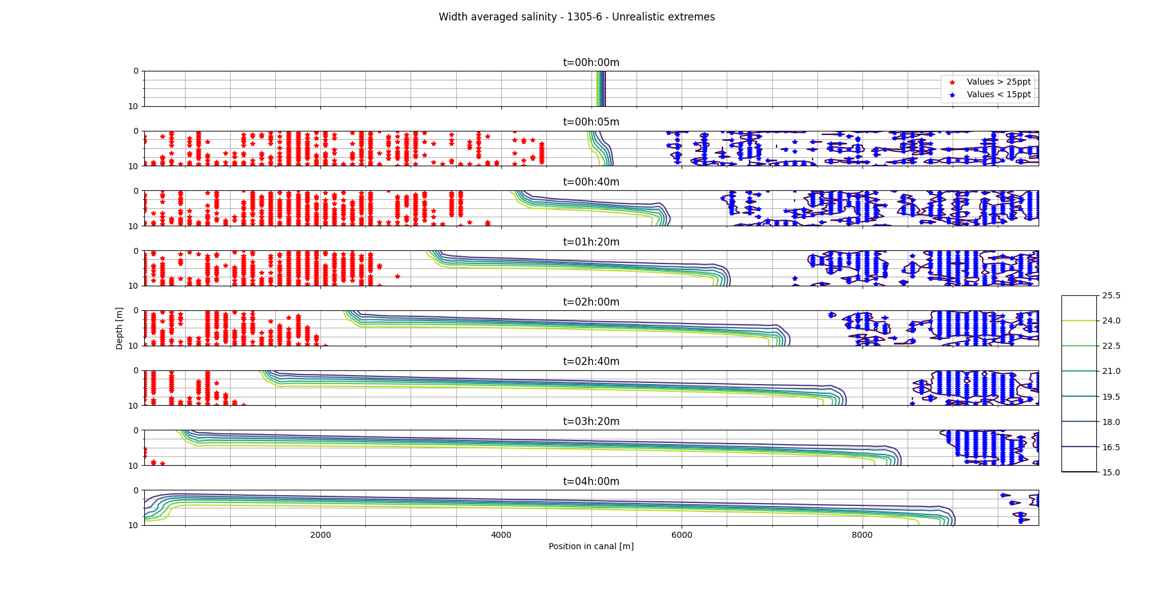
Results: Layer variation
L=20
L=20
Notes:
The frontal wave speed of the lower density current seems to increase increasing layers. The
frontal wave speed of the high density current remains almost the same. A frontal wave speed
for the low density front of 0.38 m/s, 0.39 m/s and 0.42 respectively for simulations with 20, 50
and 99 depth layers. It seems as if it will approximate the estimated value of 0.49 m/s.
• Also fewer oscillations at the location where internal waves are expected are possibly observed.

Slide 26
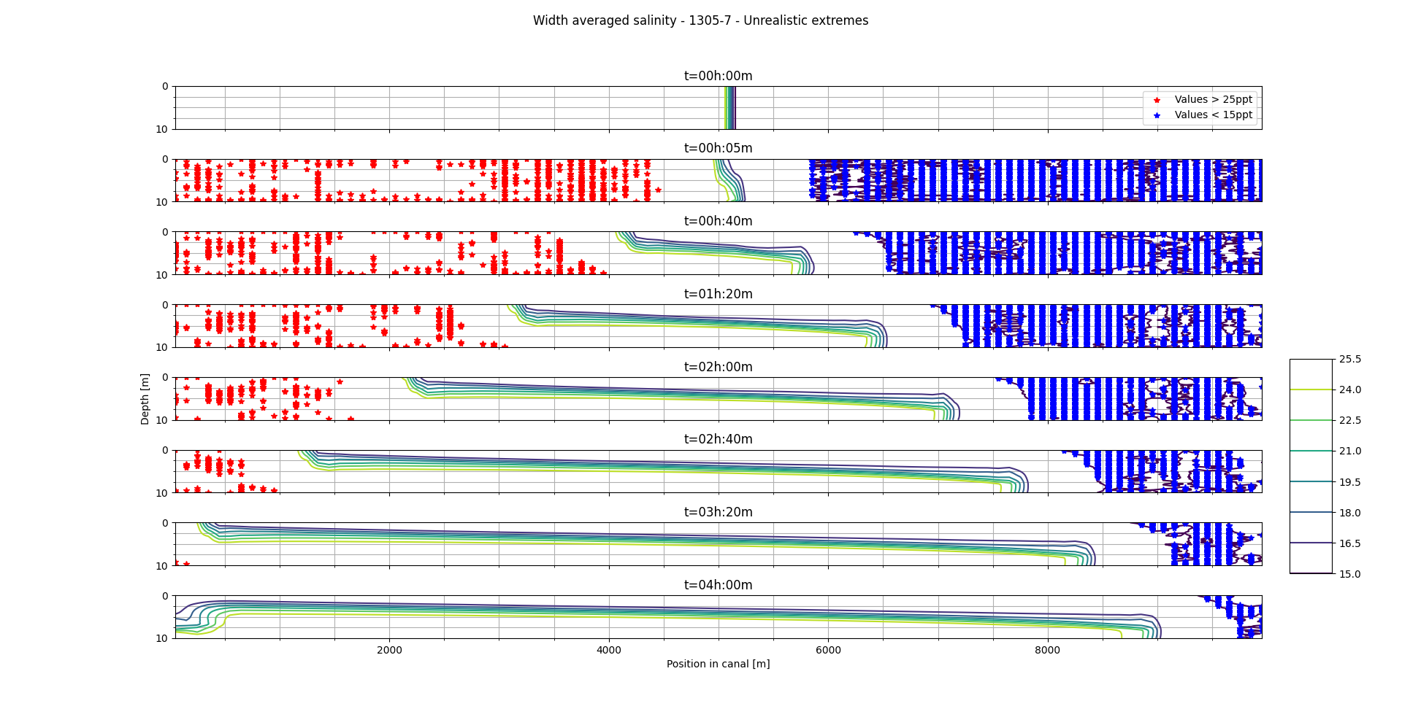
Results: Layer variation
L=50
L=50
Notes:
The frontal wave speed of the lower density current seems to increase increasing layers. The
frontal wave speed of the high density current remains almost the same. A frontal wave speed
for the low density front of 0.38 m/s, 0.39 m/s and 0.42 respectively for simulations with 20, 50
and 99 depth layers. It seems as if it will approximate the estimated value of 0.49 m/s.
• Also fewer oscillations at the location where internal waves are expected are possibly observed.

Slide 27
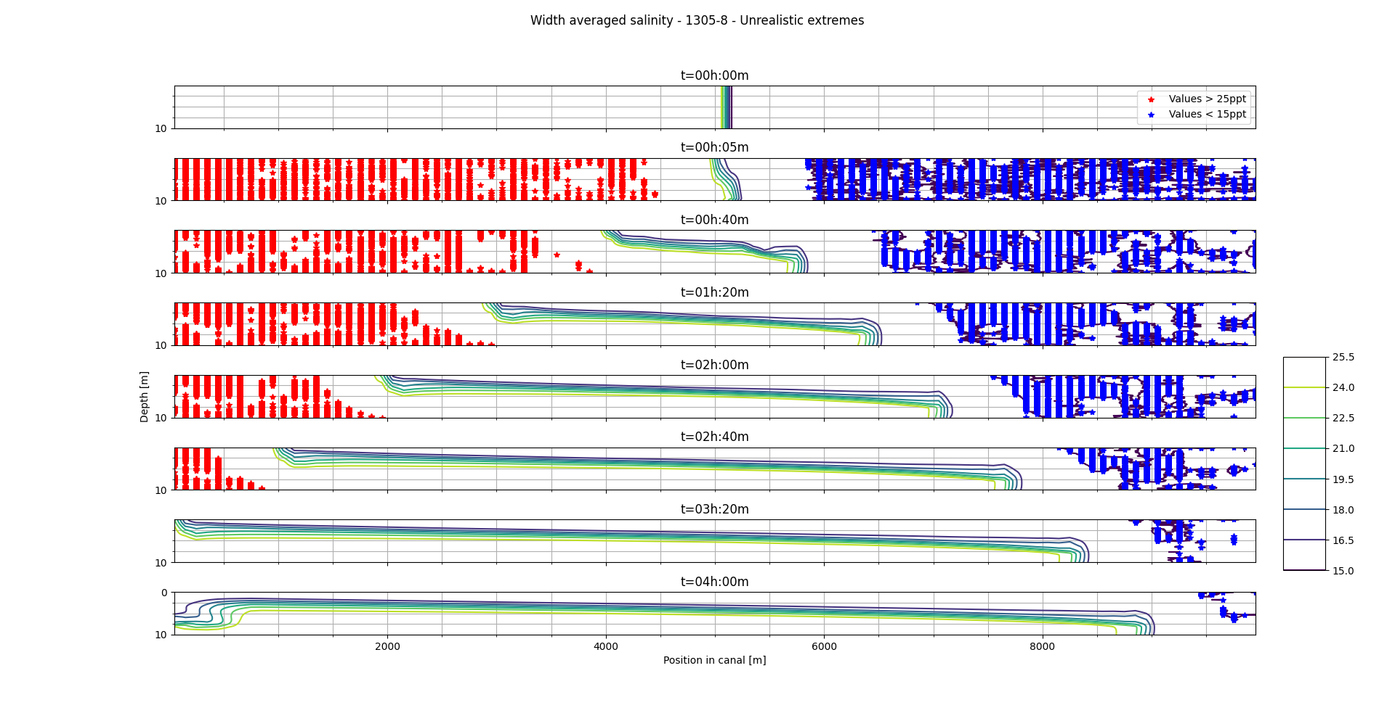
Results: Layer variation
L=99
L=99
Notes:
The frontal wave speed of the lower density current seems to increase increasing layers. The
frontal wave speed of the high density current remains almost the same. A frontal wave speed
for the low density front of 0.38 m/s, 0.39 m/s and 0.42 respectively for simulations with 20, 50
and 99 depth layers. It seems as if it will approximate the estimated value of 0.49 m/s.
• Also fewer oscillations at the location where internal waves are expected are possibly observed.

Slide 28
Results: Layer variation
Observations related to the salinity:
Higher frontal wave speed (approximating 0.49m/s)
Fewer oscillations at location internal waves
More profile at wave fronts
Notes:
• The frontal wave speed of the lower density current seems to increase increasing layers. The
frontal wave speed of the high density current remains almost the same. A frontal wave speed
for the low density front of 0.38 m/s, 0.39 m/s and 0.42 respectively for simulations with 20, 50
and 99 depth layers. It seems as if it will approximate the estimated value of 0.49 m/s.
• Also fewer oscillations at the location where internal waves are expected are possibly observed.

Slide 29
Results: General observations
Physical
Linear frontal wavespeeds
Higher FWS at 4 degrees Celsius
More detailed plot at locations of internal waves
Notes:
Physical observations
The following physical process characteristic for the lock-exchange experiment are observed during
both the temperature variations and the variations in number of z-layers.
• The frontal wave speeds at both fronts are almost linear over time. This indicates an energy
conserving approximation may be valid.
• The frontal wave speed in the high density wave is lower than in the low density wave. This is
probably because of the bed friction.
• For the temperature variations the results indicate a temperature of 4 degrees gives the highest
water density thus the highest frontal wave speed. However simulating at a higher temperature
could be more relevant, moreover the effect of the salinity difference is more noticeable, this is
taken into account in the determination of the reference model.
• For the variation of the number of layers in the vertical direction the frontal wave speed increases
a lot as the number of layers increase. It approaches a theoretical estimation as proposed by
Pietrzak [1998].

Slide 30
Results: General observations
Numerical
Linear frontal wavespeeds
Higher FWS at 4 degrees Celsius
More detailed plot at locations of internal waves
Notes:
Numerical dispersion is observed during all simulations at t=5min to deal with the initial distur-
bance in the water level. This initial disturbance is originates from the model’s hydrostatic condi-
tion and the large vertical velocity gradients at the start of the simulation.
• Numerical diffusion is possibly observed near the interface of the two density currents. In this
mixing layer where turbulence due to increased shear stresses is expected and clear oscillations
are observed when the number of layers is 10. At a higher vertical resolution these short oscilla-
tions become a large oscillation with a single wave lenght stretching the grid. This transformation
could be a result of the ratio between the horizontal and vertical resolution (1/1000 and 1/100 for
99 and 10 layers respectively) causing different modes in the approximation to be emphasized
while trying to account for turbulence in the missing layer.
• The higher resolution, in simulations with more layers, cause more oscillations in the salinity
contour lines to be visible near the front. These small oscillations are expected to be numerically
diffused turbulence that may be expected at the progressing wave fronts.

Slide 31

Conclusion
With reasonable computation times limits can be investigated. Realistic physics are observed and numerical errors are recognized. For more insight the following plots are within reach and could be interesting:
Table with extreme values
Courant limiting cells
Velocity magnitudes
3D profiles instead of width-average
Detailed plots of internal waves
Notes:
The computation times were all within reasonable limits while the number of layers in the z-direction
reached it’s limit at 99. This is a positive result considering future variations in the spatial resolution.
With respect to temperature also positive results are obtained that coincide with the expected physics,
for this parameter a constant value of 4 degrees Celsius can be reasonably determined. However to
obtain better insight in what causes the observed phenomena and how these relate to the numerical
accuracy of the model more information is required. To this end other plots that are within reach and
could be interesting are listed below:
• A table with the extreme values and there order of error
• Courant liming cells in the vertical
• Velocity magnitudes and vertical velocityThe computation times were all within reasonable limits while the number of layers in the z-direction
reached it’s limit at 99. This is a positive result considering future variations in the spatial resolution.
With respect to temperature also positive results are obtained that coincide with the expected physics,
for this parameter a constant value of 4 degrees Celsius can be reasonably determined. However to
obtain better insight in what causes the observed phenomena and how these relate to the numerical
accuracy of the model more information is required. To this end other plots that are within reach and
could be interesting are listed below:
• A table with the extreme values and there order of error
• Courant liming cells in the vertical
• Velocity magnitudes and vertical velocity
• 3D profiles instead of width averaged plots to get an idea of the numerical effects in the horizontal
• Detailed plots for the middle of the grid and at locations both fronts to get a detailed view on how
the model deals with internal waves and large disturbances respectively.
• 3D profiles instead of width averaged plots to get an idea of the numerical effects in the horizontal
• Detailed plots for the middle of the grid and at locations both fronts to get a detailed view on how
the model deals with internal waves and large disturbances respectively.

Slide 32
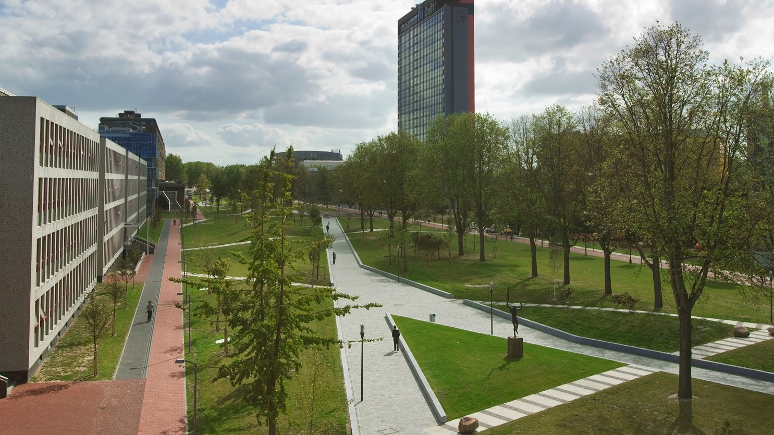
Upcoming
Interval analysis
Simulations
Notes:
The computation times were all within reasonable limits while the number of layers in the z-direction
reached it’s limit at 99. This is a positive result considering future variations in the spatial resolution.
With respect to temperature also positive results are obtained that coincide with the expected physics,
for this parameter a constant value of 4 degrees Celsius can be reasonably determined. However to
obtain better insight in what causes the observed phenomena and how these relate to the numerical
accuracy of the model more information is required. To this end other plots that are within reach and
could be interesting are listed below:
• A table with the extreme values and there order of error
• Courant liming cells in the vertical
• Velocity magnitudes and vertical velocityThe computation times were all within reasonable limits while the number of layers in the z-direction
reached it’s limit at 99. This is a positive result considering future variations in the spatial resolution.
With respect to temperature also positive results are obtained that coincide with the expected physics,
for this parameter a constant value of 4 degrees Celsius can be reasonably determined. However to
obtain better insight in what causes the observed phenomena and how these relate to the numerical
accuracy of the model more information is required. To this end other plots that are within reach and
could be interesting are listed below:
• A table with the extreme values and there order of error
• Courant liming cells in the vertical
• Velocity magnitudes and vertical velocity
• 3D profiles instead of width averaged plots to get an idea of the numerical effects in the horizontal
• Detailed plots for the middle of the grid and at locations both fronts to get a detailed view on how
the model deals with internal waves and large disturbances respectively.
• 3D profiles instead of width averaged plots to get an idea of the numerical effects in the horizontal
• Detailed plots for the middle of the grid and at locations both fronts to get a detailed view on how
the model deals with internal waves and large disturbances respectively.

Slide 33
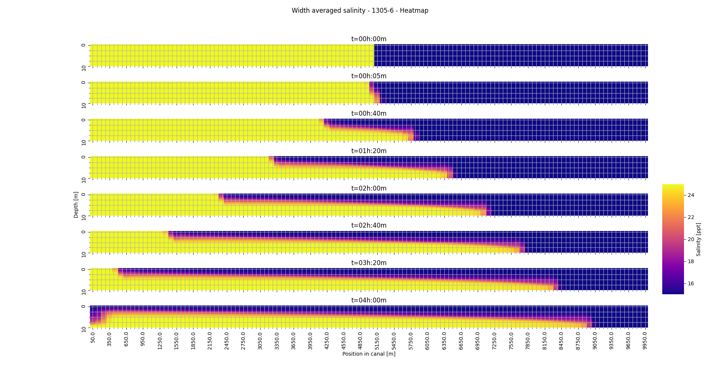
L=20
Notes:
• When the temperature is higher, in the first time step, oscillations in the water profile can be seen
in front of the disturbance, besides a large discontinuity around the center of the grid is observed.
The fact that these oscillations are not observed at a temperature of 6 degC can be explained
due to the relative effect the salinity difference has on the initial density difference, because this
effect is smaller at lower temperatures due to a higher density of the water itself the disturbance is
of a lower order than at higher temperature. These oscillations are could be a form of numerical
dispersion and may be attributed to the hydrostatic assumption of the model, i.e. to compensate
for the large vertical velocity gradient in the center of the grid at t=5min the model imposes a water
level difference (the large discontinuity). Subsequently to deal with this water level difference in
the middle of the grid, the approximation shows oscillations, i.e. in order to bridge the discontinuity
in the water level and approximate the original water level at locations where the disturbance has
not yet had any influence.
• Other oscillations are observed after the wave fronts (especially the high density wave) has
passed. These oscillations could be a result of the artificial viscosity of the model, a process
imposed to mimic energy loss due to heat transfer, this results in a transfer of kinetic energy in
the form of waves. However, they could also be a result of the internal waves formed due to
friction at the interface of the two density currents. Because in this mixing layer turbulence is
likely to occur the model could show oscillations in the water level to compensate for the vertical
velocity gradients associated with turbulence.

Slide 34

L=50
Notes:
• When the temperature is higher, in the first time step, oscillations in the water profile can be seen
in front of the disturbance, besides a large discontinuity around the center of the grid is observed.
The fact that these oscillations are not observed at a temperature of 6 degC can be explained
due to the relative effect the salinity difference has on the initial density difference, because this
effect is smaller at lower temperatures due to a higher density of the water itself the disturbance is
of a lower order than at higher temperature. These oscillations are could be a form of numerical
dispersion and may be attributed to the hydrostatic assumption of the model, i.e. to compensate
for the large vertical velocity gradient in the center of the grid at t=5min the model imposes a water
level difference (the large discontinuity). Subsequently to deal with this water level difference in
the middle of the grid, the approximation shows oscillations, i.e. in order to bridge the discontinuity
in the water level and approximate the original water level at locations where the disturbance has
not yet had any influence.
• Other oscillations are observed after the wave fronts (especially the high density wave) has
passed. These oscillations could be a result of the artificial viscosity of the model, a process
imposed to mimic energy loss due to heat transfer, this results in a transfer of kinetic energy in
the form of waves. However, they could also be a result of the internal waves formed due to
friction at the interface of the two density currents. Because in this mixing layer turbulence is
likely to occur the model could show oscillations in the water level to compensate for the vertical
velocity gradients associated with turbulence.

Slide 35
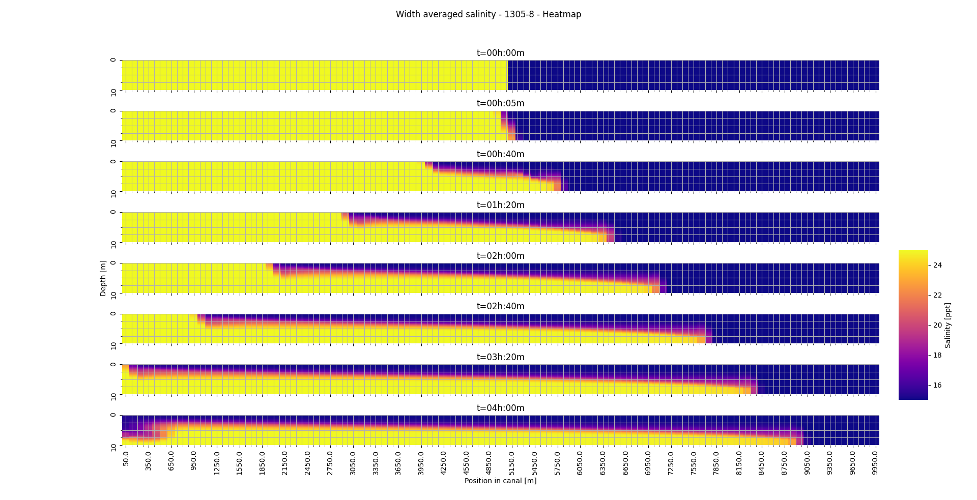
L=99
Notes:
• When the temperature is higher, in the first time step, oscillations in the water profile can be seen
in front of the disturbance, besides a large discontinuity around the center of the grid is observed.
The fact that these oscillations are not observed at a temperature of 6 degC can be explained
due to the relative effect the salinity difference has on the initial density difference, because this
effect is smaller at lower temperatures due to a higher density of the water itself the disturbance is
of a lower order than at higher temperature. These oscillations are could be a form of numerical
dispersion and may be attributed to the hydrostatic assumption of the model, i.e. to compensate
for the large vertical velocity gradient in the center of the grid at t=5min the model imposes a water
level difference (the large discontinuity). Subsequently to deal with this water level difference in
the middle of the grid, the approximation shows oscillations, i.e. in order to bridge the discontinuity
in the water level and approximate the original water level at locations where the disturbance has
not yet had any influence.
• Other oscillations are observed after the wave fronts (especially the high density wave) has
passed. These oscillations could be a result of the artificial viscosity of the model, a process
imposed to mimic energy loss due to heat transfer, this results in a transfer of kinetic energy in
the form of waves. However, they could also be a result of the internal waves formed due to
friction at the interface of the two density currents. Because in this mixing layer turbulence is
likely to occur the model could show oscillations in the water level to compensate for the vertical
velocity gradients associated with turbulence.

